Slide 1





Atliq Mart
Supply Chain Presentation
FMCG Domain
AtliQ was established in 2017 as an IT services company to help businesses integrate their processes with automated tools. Over the past 5 years, AtliQ has successfully provided many businesses with custom solutions that help them scale, or streamline their processes, reduce overhead costs and increase overall efficiency.
Manish Gupta
PGA-03, Jaipur

Slide 2


Problem Statement.
AtliQ Mart is a growing FMCG manufacturer headquartered in Gujarat, India. It is currently operational in three cities Surat, Ahmedabad and Vadodra. They want to expand to other metro/tier1 cities in the next Few years.
AtliQ Mart is currently facing a problem where a few " key customers did not extend the annual contract due to service issues".
It is speculated that some of the essential products were either "not delivered on time" or "not delivered in Full Quantity" over a continued period, which could have resulted in bad customer service.
Management wants to fix this issue before expanding to other cities and requested their supply chain analytics team to track the ‘On time’ and ‘In Full’ delivery service level for all the customers on a daily basis so that they can respond swiftly to these issues.
The Supply Chain team decided to use a standard approach to measure the service level in which they will measure ‘on-time delivery (OT) %’, ‘In-full quantity delivery (IF) %’ and OnTime in full quantity (OTIF) % of the customer orders on a daily basis against the target service level set for each customer.

Slide 3

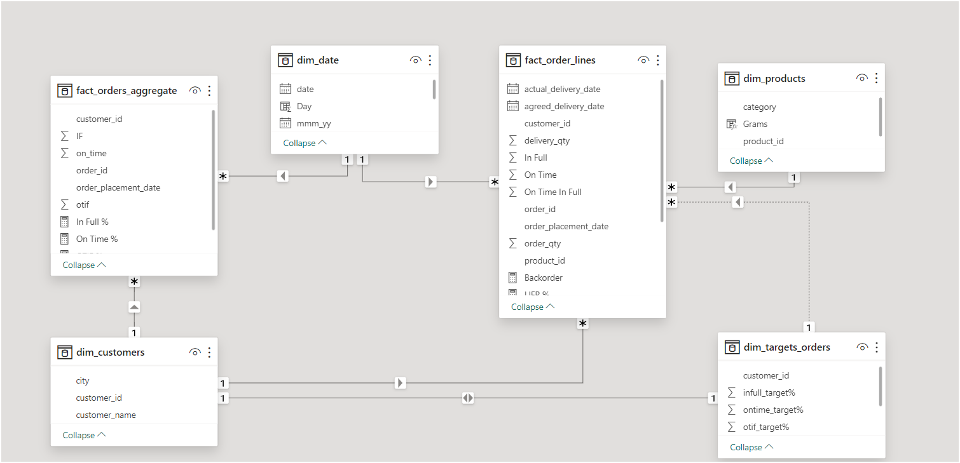
Model View
- Active and Inactive relationships

Slide 4
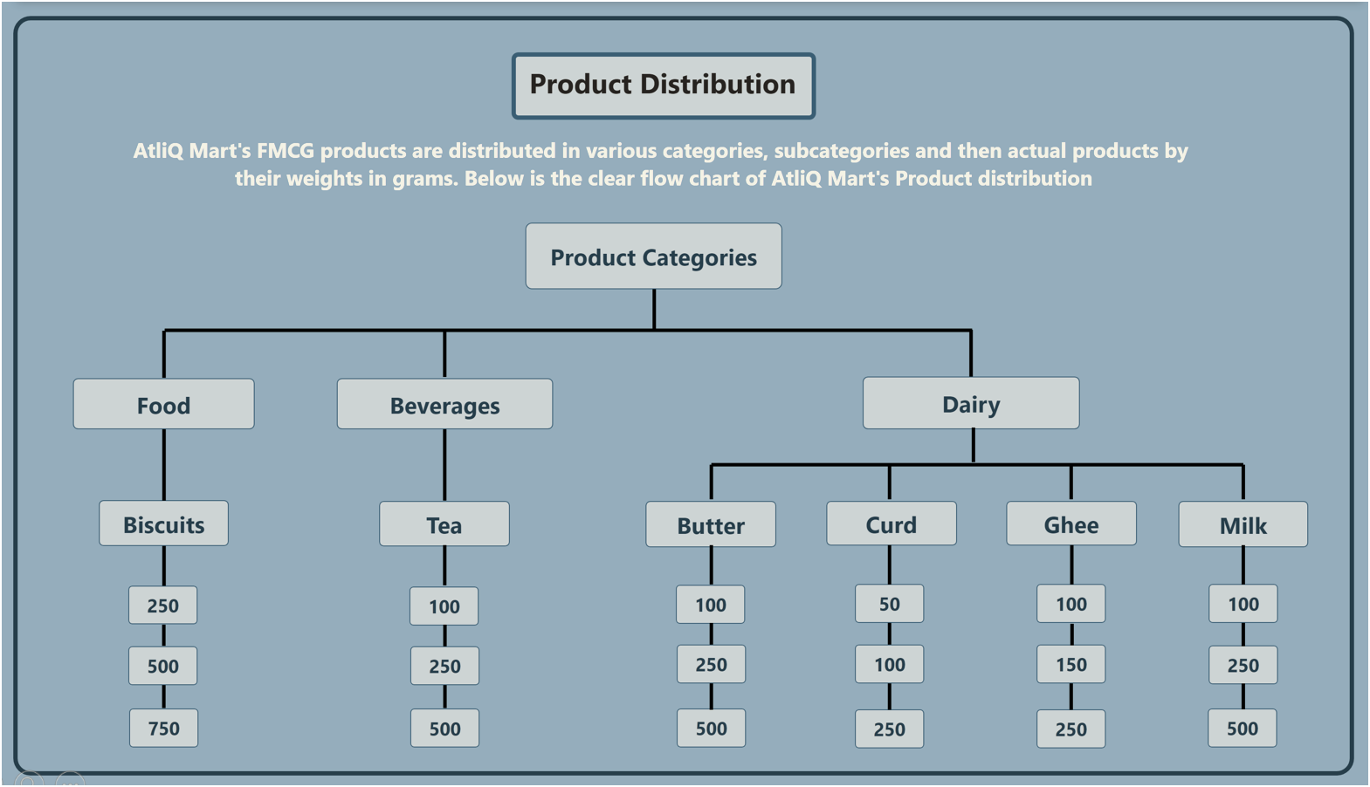
Product Distribution

Slide 5

Standard Approach
IF = order is delviered in full quantity or not. (0,1)
OT = order is delviered on time Or not. (0,1)
Format = Percentage
OTIF = order is delviered both on time and in full quantity or not. (0,1)
Total Orders = COUNT(fact_orders_aggregate[ order_id ])
On Time % =
SUM(fact_orders_aggregate[ on_time ])
Total orders
In Full % =
SUM(fact_orders_aggregate[ IF ])
Total orders
OTIF % =
SUM(fact_orders_aggregate[ otif ])
Total orders

Slide 6
Orders and Lines
Orders are nothing but a unique request placed by a customer on a given date.
Within an order, a customer could request multiple items. Each of these items requested within the order is called an order line.
in one order have multiple unique products(order line).
Example: Let's say you order at lotus mart.
4 (milk 500),
1 (tea 500) and
2 (biscuits 500)
Lotus mart is able to ship you
1 (tea 500) and
1 (biscuits 500)
4 (milk 500),
VOFR% ( Volume Fill rate) =
total shipped quantity
total ordered quantity
6
7
= 86%
LIFR% ( Line Fill rate) =
lines fulfilled
lines ordered
2
3
= 66%

Slide 7
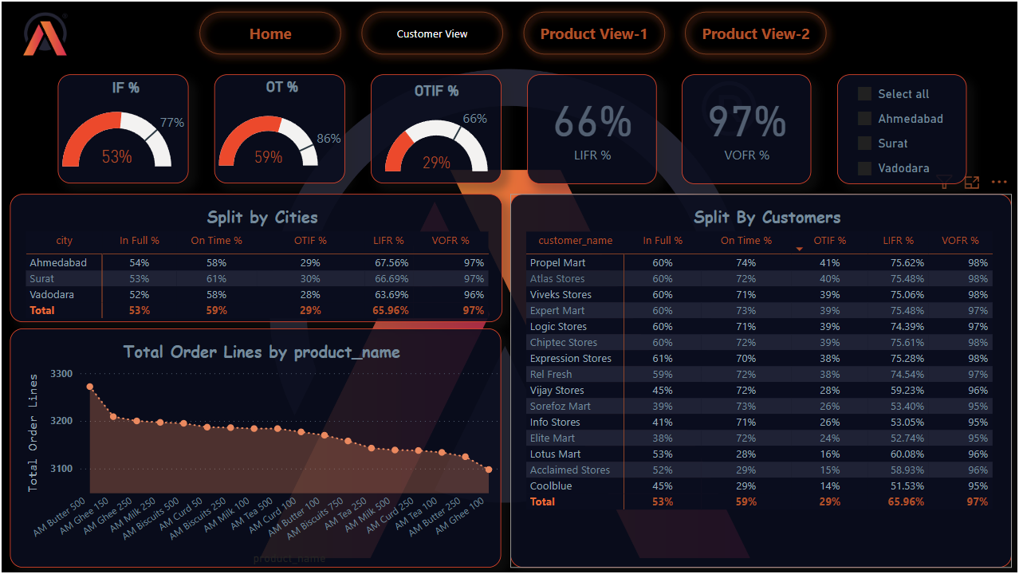

KPI`s
In Full Quantity ( IF % ) - all the line items inside the order are delivered In Full Quantity.
VOFR% - Volume Fill rate will be total quantity shipped / total quantity ordered
OTIF% - order is delivered BOTH in full and On Time as per the customer order request.
LIFR% - order is delivered in full as per the requested quantity by the customer.
on time delivery ( OT% ) - all the line items inside the order is delivered on time.

Slide 8
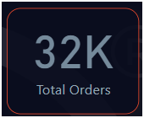
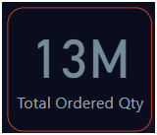
KPI`s

Slide 9
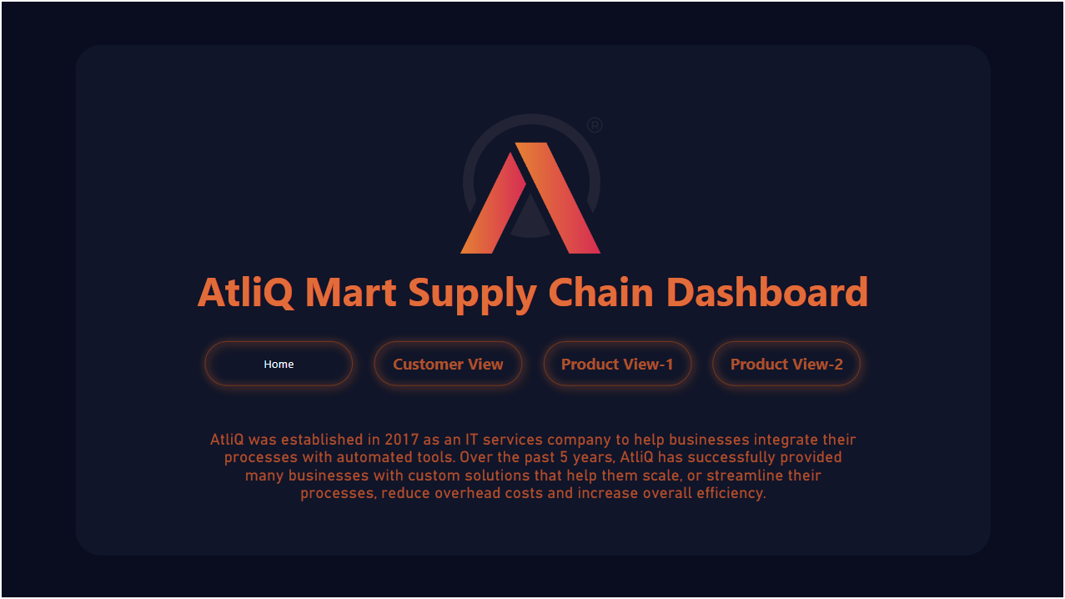

Slide 10

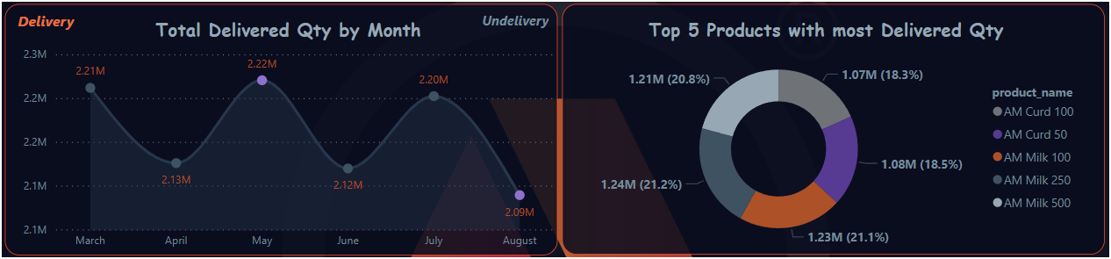
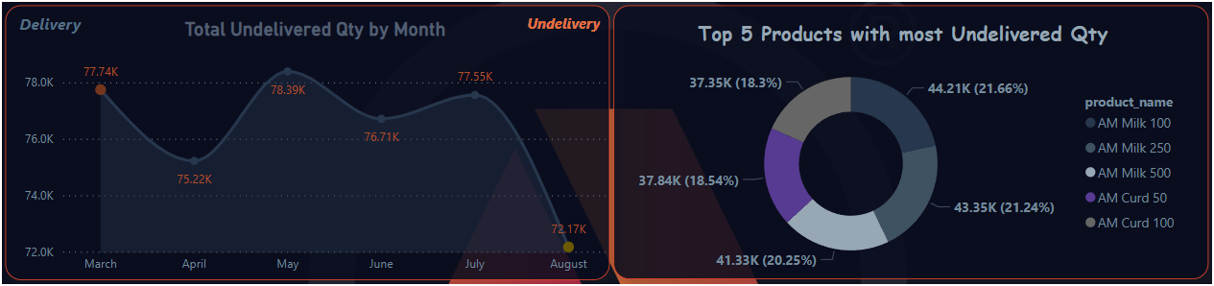

Slide 12
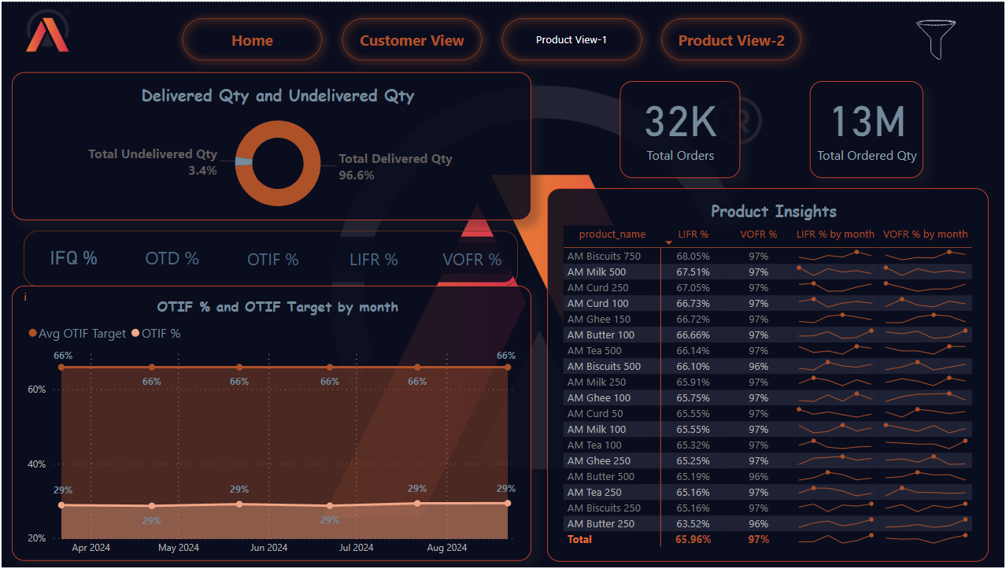

Slide 13
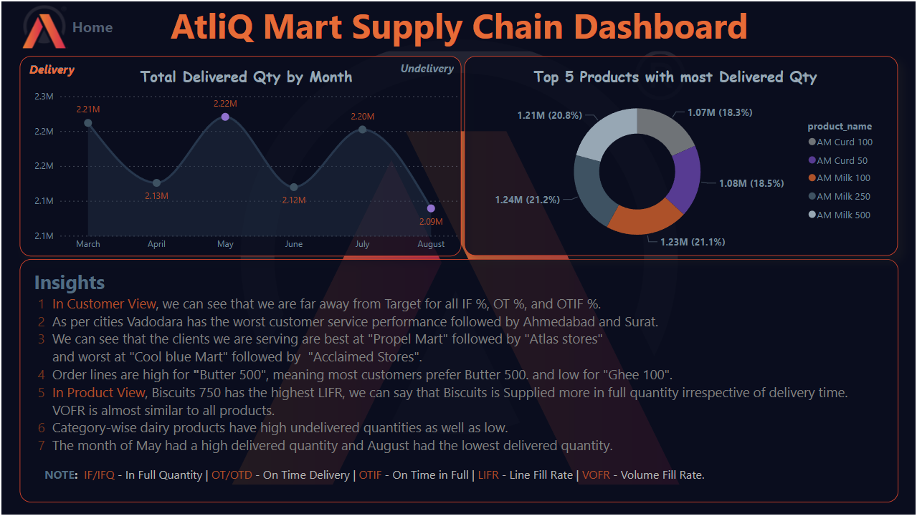

Slide 14
Thank You

